Slide 1
Forma AI
Technical Challenge
By: Sohail Shaikh
GitHub
LinkedIn

Slide 2
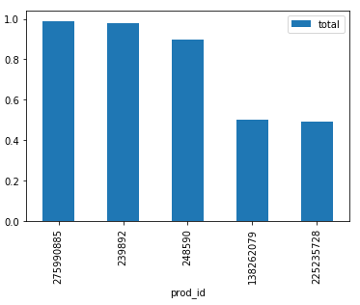
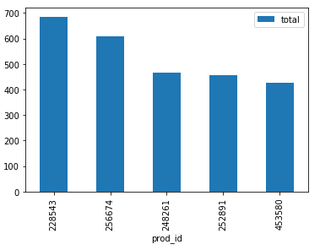
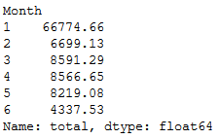
Insights on transactions
The top left bar graph displays which products were sold the least and their revenue.
The bottom left bar graph displays which products were sold the most and their revenue.
The bottom right list displays the total revenue generated each month.
Based on these bullets, we can see that the company generated the most revenue in the month of January. We can also see the top five products that generated the most revenue for the year as well as which products generated the least amount of revenue.
One business assumption I’d make based on this data is that January generated the most revenue because after the Christmas season, people typically have gift cards and money given as gifts to spend.

Slide 3
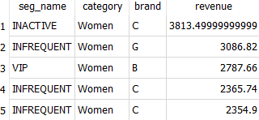
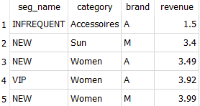
Insights on products
The top graph displays which brands and categories made the highest revenue, along with segment names.
The bottom graph displays which brands and categories made the lowest revenue, along with segment names.
The ‘Women’ category and brand C dominates for highest revenue which includes INACTIVE segment.
The ‘Women’ category and brands A and M generate the least revenue.
Based on these bullets, it can be assumed that products in the ‘Women’ category are sold the most, with brand C being the most popular within the category.
One business assumption I’d make is that brands A and M are new brands are newer and less established.

Slide 4
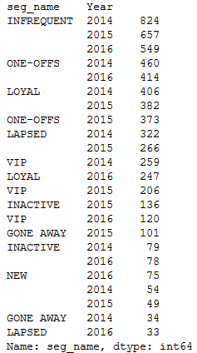
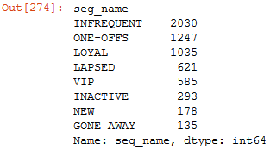
Insight on customer segments
The list of segments on the left displays the highest count each segment achieved, split up by year.
The list of segments on the right displays the total count of each segment for the entire dataset.
From these lists, it can be assumed that INFREQUENT has the highest segment count both by year and in general.
Following the INFREQUENT segment is ONE-OFFS.
The GONE AWAY segment has the lowest count.
Based on these bullets, it can be assumed that a majority of transactions come from infrequent buyers (INFREQUENT) and buyers who only purchase products once (ONE-OFFS).

Slide 5
Thanks!
Any questions ?
You can contact me at:
GitHub
LinkedIn
sohail.shaikh7208@gmail.com

